Slide 1
Unstructured data and applications
Vijayalakshmi Anand

Slide 2
Text Books
Data Mining: Concepts and Techniques, Second Edition 2005 by Jiawei Han and Micheline Kamber Morgan Kaufmann Publishers
Text Data Management and Analysis: A Practical Introduction to Information Retrieval and Text Mining ChengXiang Zhai, Sean Massung, ACM Books 2016
Web data Mining - Exploring Hyperlinks, Contents and Usage Data, By Bing Liu, Second Edition, Springer, July 2011
Source Courtesy: Some of the contents of this presentation are sourced from materials provided by publishers of prescribed books

Slide 3
What is Natural Language Processing?
Natural Language Processing
Process information contained in natural language text.
Also known as Computational Linguistics (CL), Human Language Technology (HLT), Natural Language Engineering (NLE)

Slide 4

Natural Language processing
Increase of online data
Process unstructured data and extract meaningful information
Challenges
Solution-Natural langue processing

Slide 5


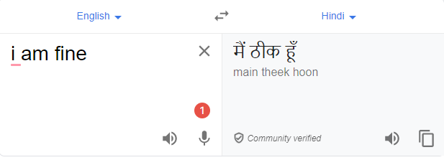

Application of NLP

Slide 6
Why NLP hard?
Ambiguity
Eg:
Teacher strikes idle kids.
Sarah gave a bath to her dog wearing a pink t-shirt.
RBI raises interest rates.

Slide 7
Ambiguities at all level
Structural Ambiguities
Namrata thinks she understands me.
She thinks Namrata understands me.
Visiting relatives can be nuisance. (two meanings)
Grammatical Ambiguities
I (feminine or masculine) go.
Can- Noun = container, Can – Modal(auxiliary verb),
Can-verb = to can means to pack etc
Lexical Ambiguities:
Polysemy Ex: "understand" (I get it)
Homonymy Ex: Bank= river, financial bank
Notes:
The challenges we face stem from the highly ambiguous nature of natural language. As an English speaker you effortlessly understand a sentence like "Flying planes can be dangerous". Yet this sentence presents difficulties to a software program that lacks both your knowledge of the world and your experience with linguistic structures. Is the more plausible interpretation that the pilot is at risk, or that the danger is to people on the ground? Should "can" be analyzed as a verb or as a noun? Which of the many possible meanings of "plane" is relevant? Depending on context, "plane" could refer to, among other things, an airplane, a geometric object, or a woodworking tool. How much and what sort of context needs to be brought to bear on these questions in order to adequately disambiguate the sentence?
Polysemy: Verbs with three levels of meanings
1) Literary, 2) Abstract, 3) Frozen
Ex: The man drank the apple juice (Literary)
The car drank gasoline (Abstract)
The idea drank the heart (Frozen)
Homonymy : Category same still different meaning

Slide 8
Some of the tasks involved in NLP
Tokeniztion
splits longer strings of text into smaller pieces, or tokens.
Eg:JavaTpoint offers Corporate Training, Summer Training, Online Training, and Winter Training.
"JavaTpoint", "offers", "Corporate", "Training", "Summer", "Training", "Online", "Training", "and", "Winter", "Training", "."
Lemmatization
capture canonical forms based on a word's lemma.
Eg:better → good

Slide 9
Contd..
Stemming
process of eliminating affixes (suffixed, prefixes, infixes, circumfixes) from a word in order to obtain a word stem.
eg. running → run
Stop Words
contribute little to overall meaning
Eg:He is a good boy.

Slide 10
N-gram language models
An N-gram model is one type of a Language Model (LM), which is about finding the probability distribution over word sequences
E.g:
There was heavy rain
There was heavy flood.

Slide 11
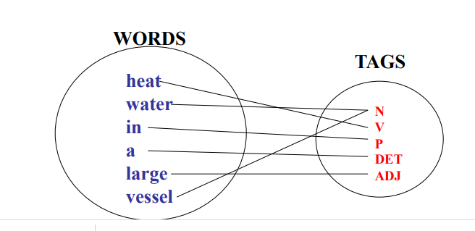
POS tagging
The process of assigning a part-of-speech to each word in a sentence

Slide 12
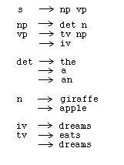
Grammars and parsing
list of rules that define the set of all well-formed sentences in a language

Slide 13
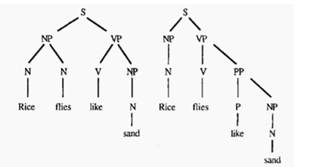
Parsing
Find that how all the words in the sentence are related to each other

Slide 14
Word sense disambiguation
the task of determining which sense of a word is being used in a particular context.
Eg:
“The bank will not be accepting cash on Saturdays. ”
“The river overflowed the bank

Slide 15
Mining multimedia data

Slide 16
Multimedia data
Multimedia data -image data, video data, audio data, as well as sequence data
1.Similarity search in multimedia data
2.Multidimensional data
3.Mining association in multimedia data

Slide 17
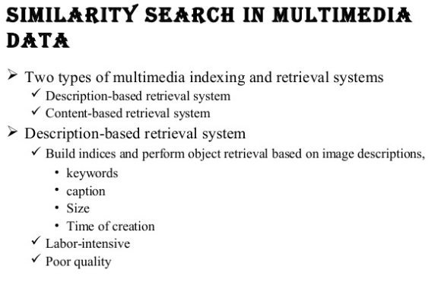

Slide 18
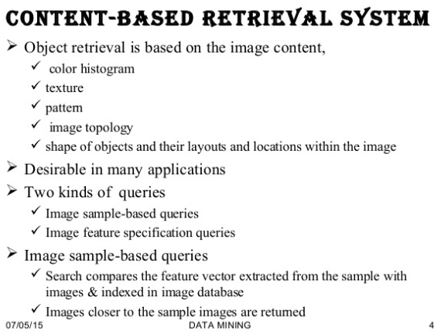

Slide 19
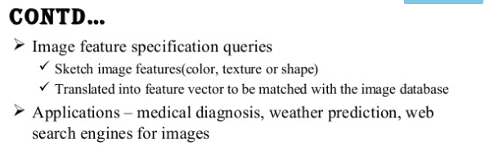

Slide 20
Multidimensional Analysis of Multimedia Data
Multimedia data cube
Design and construction similar to that of traditional data cubes from relational data
Contain additional dimensions and measures for multimedia information, such as color, texture, and shape

Slide 21
Mining Associations in Multimedia Data
Three categories of Association rules can be observed involving multimedia objects in image and video databases.
Associations between image content and non-image content features
Associations among image contents that are not related to spatial relationships
Associations among image contents related to spatial relationships

Slide 22
Mining spatial data

Slide 23
What Is a Spatial Database System?
Geometric, geographic or spatial data: space-related data
Example: Geographic space (2-D abstraction of earth surface), VLSI design, model of human brain, 3-D space representing the arrangement of chains of protein molecule.
Spatial database system vs. image database systems.
Image database system: handling digital raster image
Spatial (geometric, geographic) database system: handling objects in space that have identity and well-defined extents, locations, and relationships.

Slide 24
GIS vs. SDBMS
GIS (Geographic Information System)
Analysis and visualization of geographic data
Common analysis functions of GIS
Search (thematic search, search by region)
Location analysis (buffer, corridor, overlay)
Terrain analysis (slope/aspect, drainage network)
Flow analysis (connectivity, shortest path)
Distribution (nearest neighbor, proximity, change detection)
Spatial analysis/statistics (pattern, centrality, similarity, topology)
Measurements (distance, perimeter, shape, adjacency, direction)
Spatial DBMS (SDBMS) is a software system that
supports spatial data models, spatial ADTs, and a query language supporting them
supports spatial indexing, spatial operations efficiently, and query optimization
can work with an underlying DBMS
Examples
Oracle Spatial Data Catridge
ESRI Spatial Data Engine

Slide 25
Graph/Network Mining

Slide 26
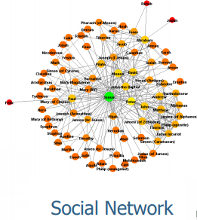
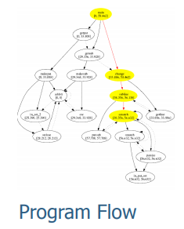
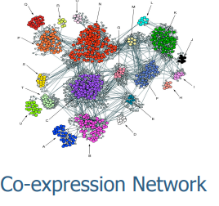
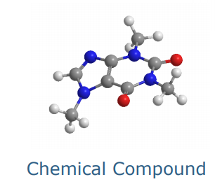
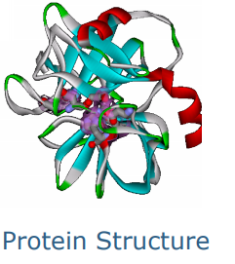
Why Graph Mining?
Graphs are everywhere

Slide 27
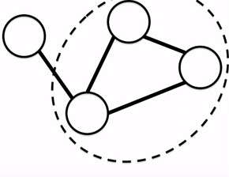
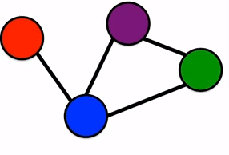
Basics
Nodes
Edges
Undirected
Directed

Slide 28
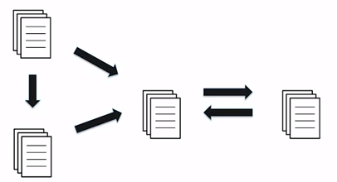
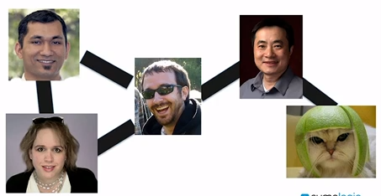
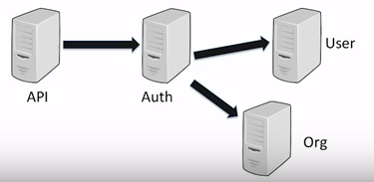
Applications
Graph | Nodes | Edges
Social | People | Friendship
Web | Pages | Links
System | Services | API Calls

Slide 29
Graph Pattern Mining
Frequent subgraphs
A (sub)graph is frequent if its support (occurrence frequency) in a given dataset is no less than a minimum support threshold

Slide 30
Example: Frequent Subgraphs
GRAPH DATASET
(A)
(B)
(C)
FREQUENT PATTERNS
(MIN SUPPORT IS 2)
(1)
(2)

Slide 31
Graph Mining
Graph Pattern Mining
Mining graph patterns can be categorized into Apriori-based and pattern growth–based approaches
Used to find Frequent subgraphs
A (sub)graph is frequent if its support (occurrence frequency) in a given dataset is no less than a minimum support threshold

Slide 32
Application
Sentiment analysis
Recommendation system
Fraud detction

Slide 33
Sentiment analysis

Slide 34
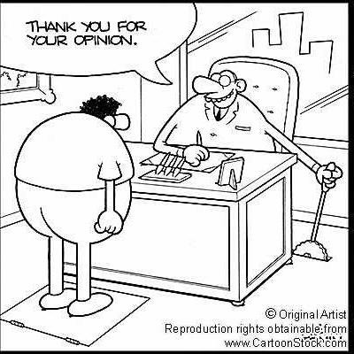
Motivation For Sentiment Analysis
What others think has always been an important piece of information
“Which car should I buy?”
“Which schools should I apply to?”
“Which Professor to work for?” “Whom should I vote for?”

Slide 35


“So whom shall I ask?”
Pre Web
Friends and relatives
Acquaintances
Consumer Reports
Post Web
“…I don’t know who..but apparently it’s a good phone. It has good battery life and…”
Blogs (google blogs, livejournal)
E-commerce sites (amazon, ebay)
Review sites (CNET, PC Magazine)
Discussion forums (forums.craigslist.org,
forums.macrumors.com)
Friends and Relatives (occasionally)

Slide 36




What is Sentiment analysis
Computational study of opinions, sentiments, evaluations, attitudes, appraisal, affects, views, emotions, subjectivity, etc., expressed in text.

Slide 37
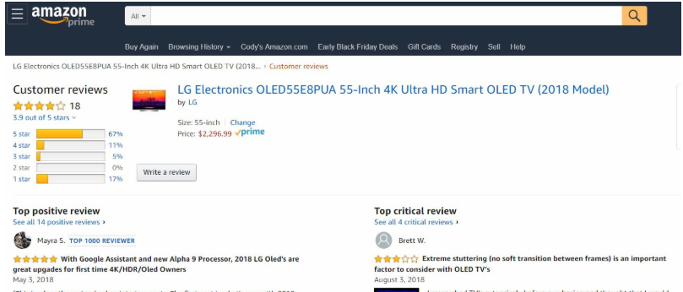
Examples

Slide 38
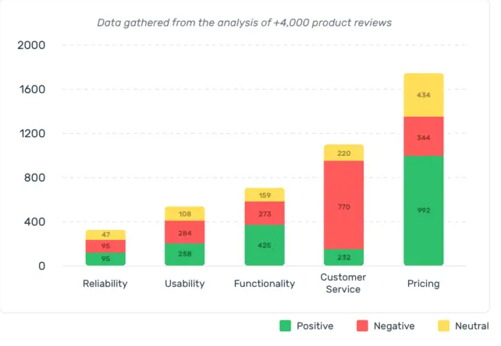

Slide 39
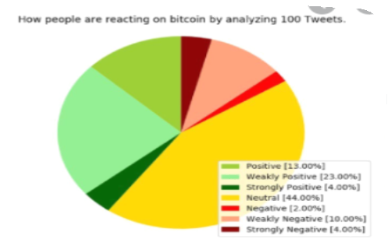

Slide 40
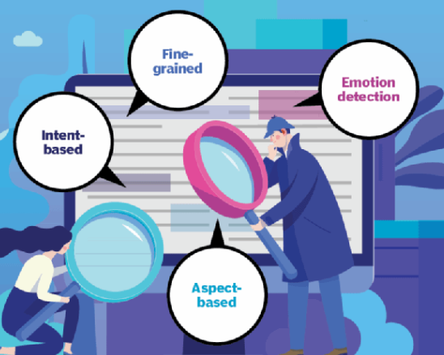

Types of Sentiment Analysis
Positive ,Neutral,Negative
intention to sell, intention to complain or intention to purchase etc
“This battery of camera is too short “

Slide 41
Sentiment analysis methods
Rule-based systems that perform sentiment analysis based on a set of manually crafted rules.
Automatic systems that rely on machine learning techniques to learn from data.
Hybrid systems that combine both rule-based and automatic approaches.

Slide 42
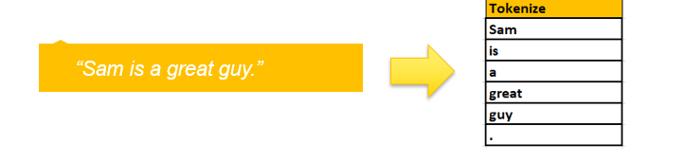
Example
“Sam is a great guy”
1.Tokenize

Slide 43
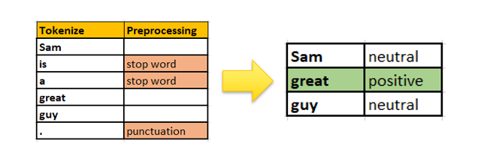
2.Remove stop words and punctuations

Slide 44
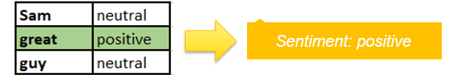
3. Running the lexicon on the preprocessed data, returns a positive sentiment score/measurement because of the presence of a positive word “great” in the input data.

Slide 45
Machine learning Approach
The song was good .
1.Tokenization
The
Song
Was
Good
.
2.Cleaning the data (Remove special characters )
The
Song
Was
Good

Slide 46
Contd..
3.Remove stop words.
Song
good
4.Classification(Positive, negative ,Neutral)
Apply supervised algorithm
Naïve Byes
Support vector machines
Maximum Entropy

Slide 47
Sentiment Lexicons
Many sentiment applications rely on lexicons to supply features to a model.
A lexicon is a resource with information about words.
A sentiment lexicon has information such as list of words which are positive and negative.

Slide 48
SentiWordNet
Home page :http://sentiwordnet.isti.cnr.it/
All WordNet synsets automatically annotated for degrees of positivity ,negativity and neutrality/objectiveness.

Slide 49
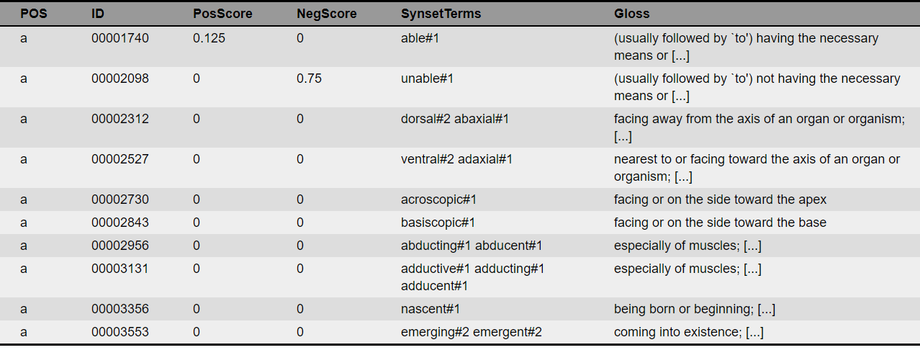
Example

Slide 50
Recommendation system

Slide 51


Motivation for Recommender Systems
Vast amount of digital information available
What music to listen what movie to see what book to read etc.
Search Vs Recommender systems

Slide 52
What is recommender system
A recommender system is a type of information filtering system.
A recommendation system, or recommender system tries to make predictions on user preferences and make recommendations which should interest customers.

Slide 53
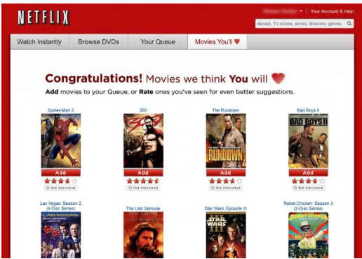
Netflix-Movie recommendation

Slide 54
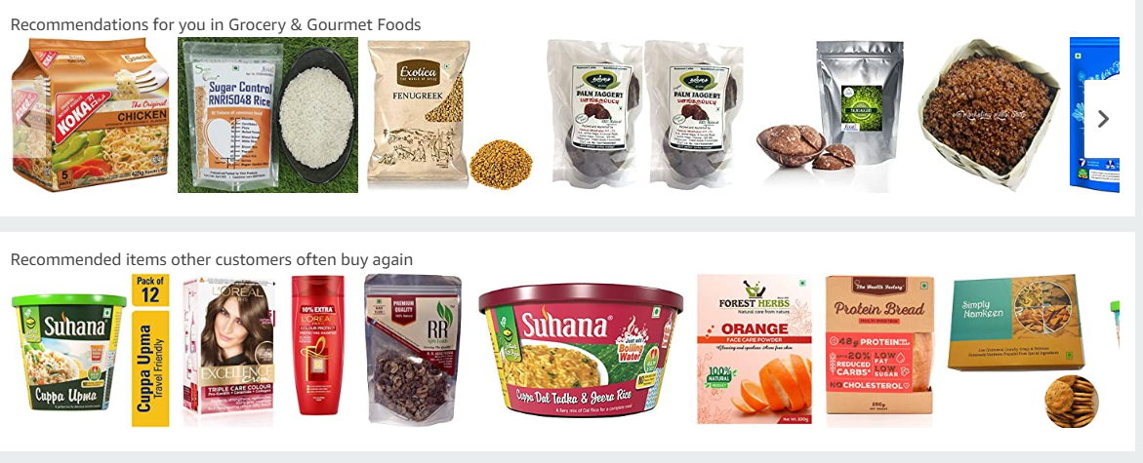
Amazon recommendation system

Slide 55
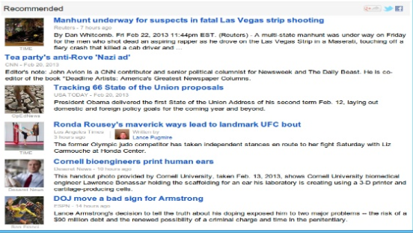
Google news

Slide 56
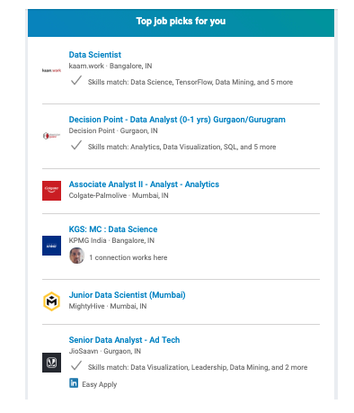
Linkedin

Slide 57
What is collaborative filtering
For each user, recommender systems recommend items based on how similar users liked the item
Two approaches
Memory based :
User-based: measure the similarity between target users and other users
Item-based: measure the similarity between the items that target users rates/ interacts with and other items
Model based
SVD,PCA.. etc

Slide 58
User Based Collaborative Filtering
Identify the set of items rated by the target user.
Identify which other users have rated the same items as target user.
Compute similarity of each user to the target user.
Select top K similar users
User/Movie | Batman | Alice in Wonderland | Dumb and Dumber | Equilibrium
User A | 4 |  | 3 | 5
User B |  | 5 | 4
User C | 5 | 4 | 2
User D | 2 | 4 |  | 3
User E | 3 | 4 | 5 | ?

Slide 59
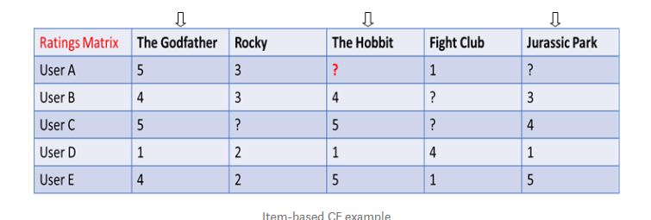
Item Based Collaborative Filtering

Slide 60
Advantages
1.They help users deal with the information overload by giving them recommendations of products, etc.
2. They help businesses make more profits, i.e., selling more products.

Slide 61
Challenges
Scalability.
Cold Start
Imbalanced Dataset.

Slide 62
Fraud detection

Slide 63
What is fraud detection
Sophisticated data mining tools are used to analyze millions of transactions to detect patterns that are consistent with fraudulent behavior

Slide 64
What are the business benefits of fraud detection?
Fraud detection solutions enable businesses to detect and stop fraud in progress—whether it be a payment, an insurance claim .
The ability to detect actual fraud in real time reduces both loss and manual intervention costs.

Slide 65
Thank You… ☺
Q&A
Suggestions / Feedback

